Slide 1
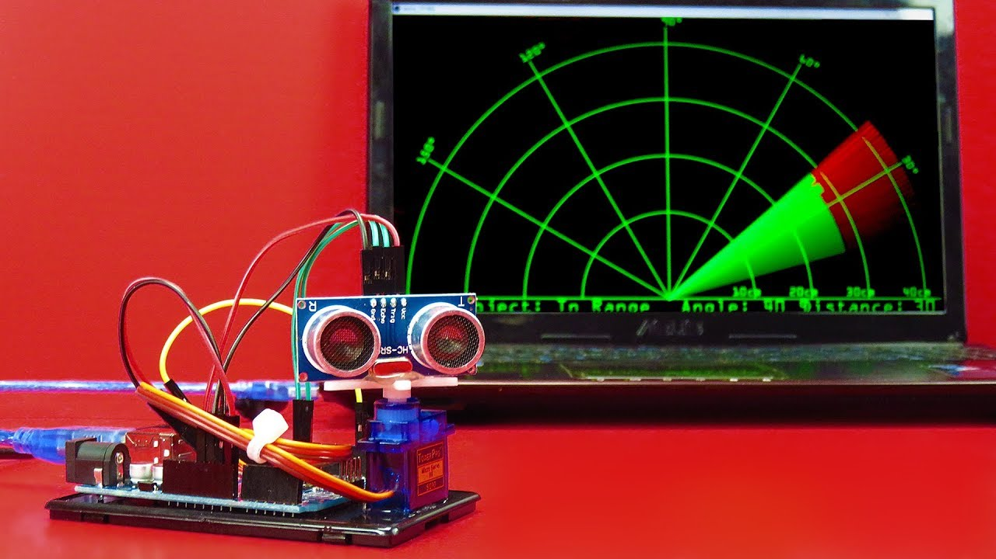
RADAR SYSTEM
ABHINAV KUMAR RAI :1MS18CS004
AVANEESH BINDAL :1MS18CS033
ARYA KUMARI :1MS18IS019

Slide 2
PROBLEM STATEMENT
To create a RADAR SYSTEM which can detect any object/obstacles in a particular range and display its precise location and distance on the SCREEN and trigger an alarm/buzzer on detection.

Slide 3
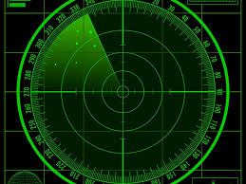
INTRODUCTION
WHAT IS RADAR ?
Radar is a device that transmits ultrasonic waves, which travels and get reflected if there is any obstacles in its range at the receiver.
It helps in finding the distance and location of the target or obstacle.
USES :(large scale)
MILITARY STSTEMS
AIR BASES SYSTEM
SUBMARINES / SHIPS, etc.

Slide 4
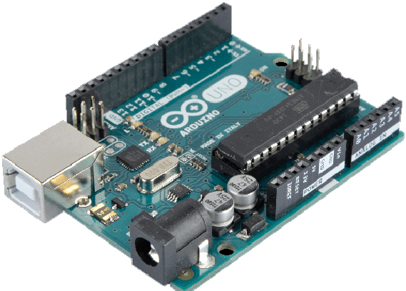
Why Arduino Board?
Arduino is an open source that allows anyone interested to contribute.
Arduino software consists of IDE and libraries. IDE is a cross-platform application written in Java.The libraries are written in C and C++.
H/W requirement -Easy interfacing with sensors and data collection.
S/W requirement- Everyone can use IDE, python, ruby, embedded C etc for programming it.

Slide 5
COMPONENTS USED
ARDUINO UNO
ULTRASONIC SENSOR(HC-SR04)
SERVO MOTOR
BUZZER
BREAD BOARD
JUMPER WIRES

Slide 6
WORKING
ROTATION OF ULTRASONIC SENSOR MOUNTED ON SERVO MOTOR
DETECTION OF ANY OBJECT OR OBSTACLE
ACTIVATION OF BUZZER ON DETECTION
DISPLAYING DISTANCE AND LOCATION OF OBJECT ON SCREEN

Slide 7
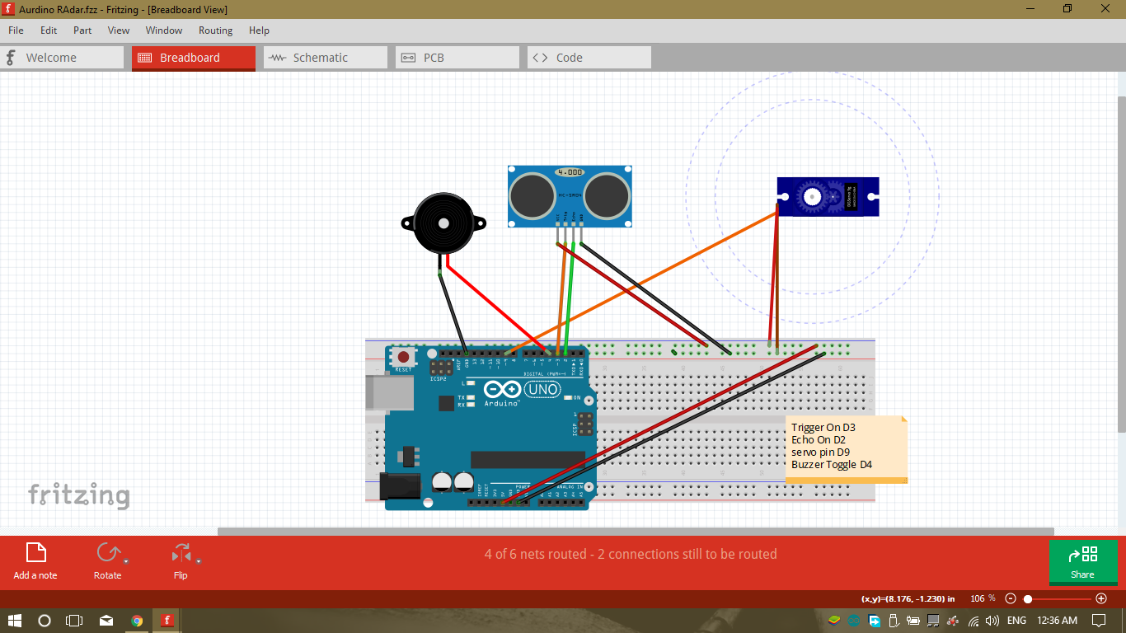
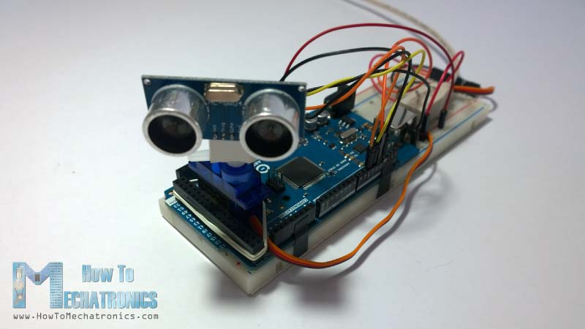
CIRCUIT DIAGRAM
CIRCUIT CONNECTIONS

Slide 8
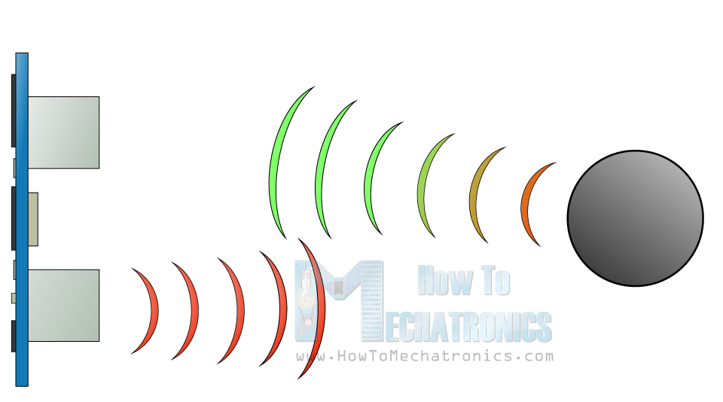
How It Works – Ultrasonic Sensor
It emits an ultrasound at 40 000 Hz which travels through the air and if there is an object or obstacle on its path It will bounce back to the module. Considering the travel time and the speed of the sound you can calculate the distance.
The HC-SR04 Ultrasonic Module has 4 pins, Ground, VCC, Trig and Echo.
Trigo pin- sends/emits ultrasound
Echo pin- receives reflected waves.

Slide 9
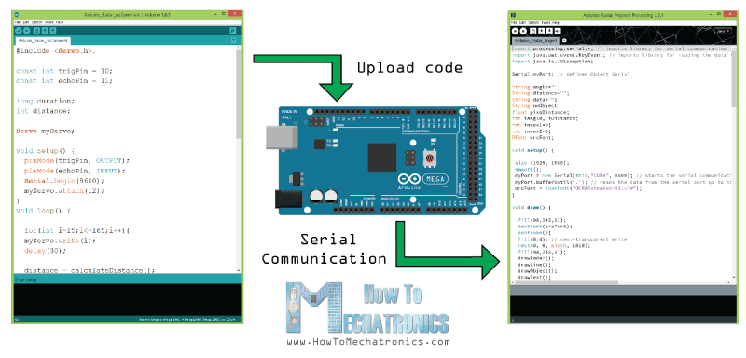
CODING
ARDUINO:
SETUP ()
LOOP()
CALCULATEDISTANCE()
JAVA(In Processing IDE):
PROCESSING LIB
AWT LIB
IO LIB
SETUP()
DRAWLINE()
DRAWRADAR()
DRAWOBJECT()
DRAWTEXT()
SERIALEVENT()

Slide 10
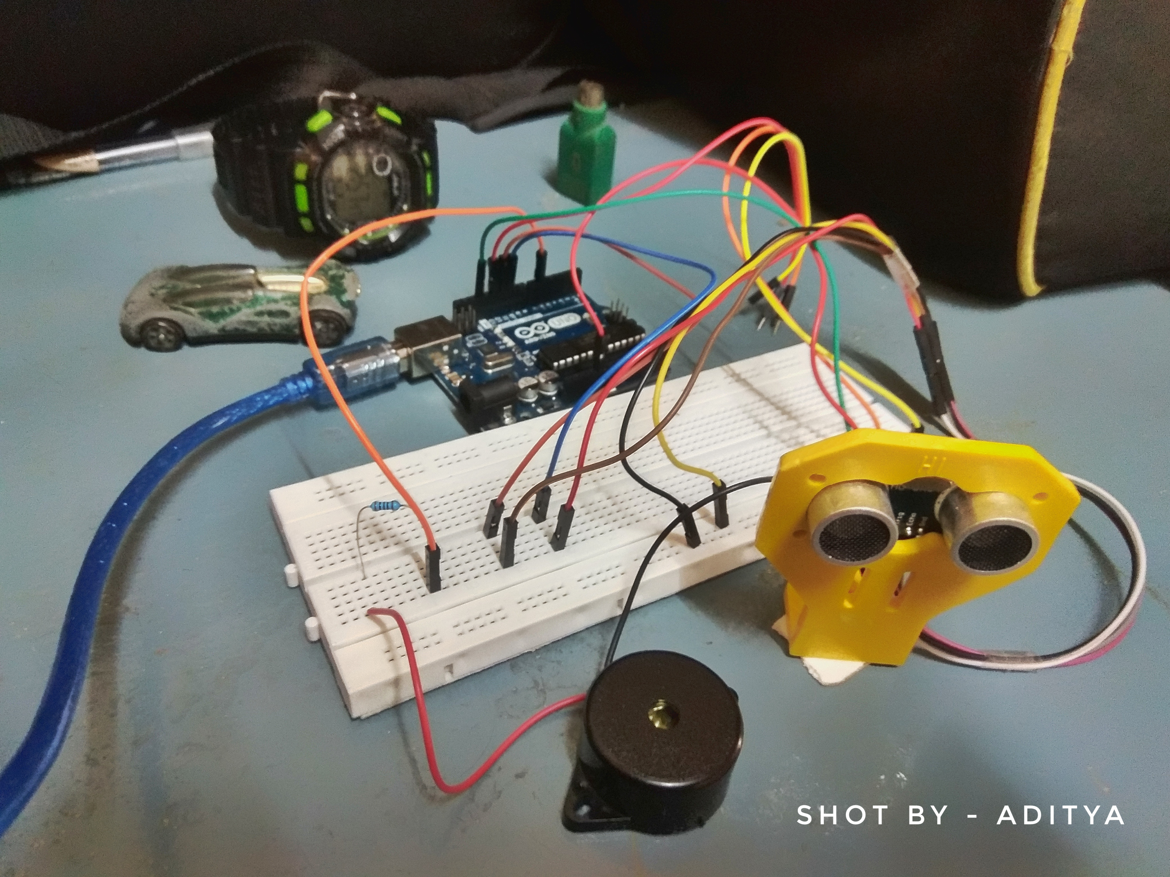
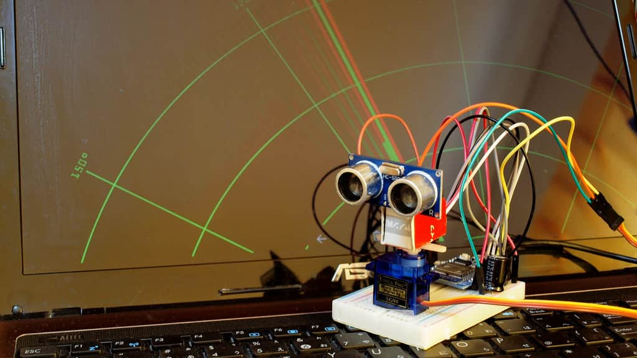
OUTPUT SAMPLES

Slide 11
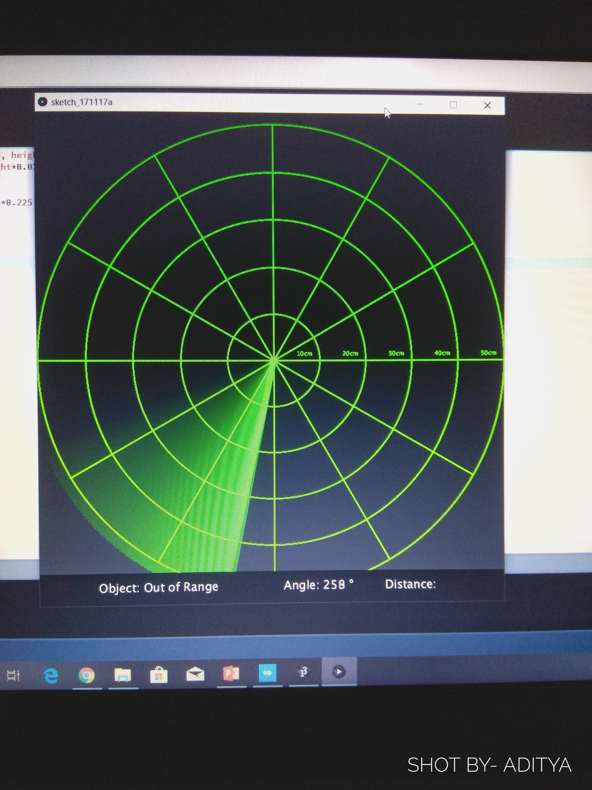
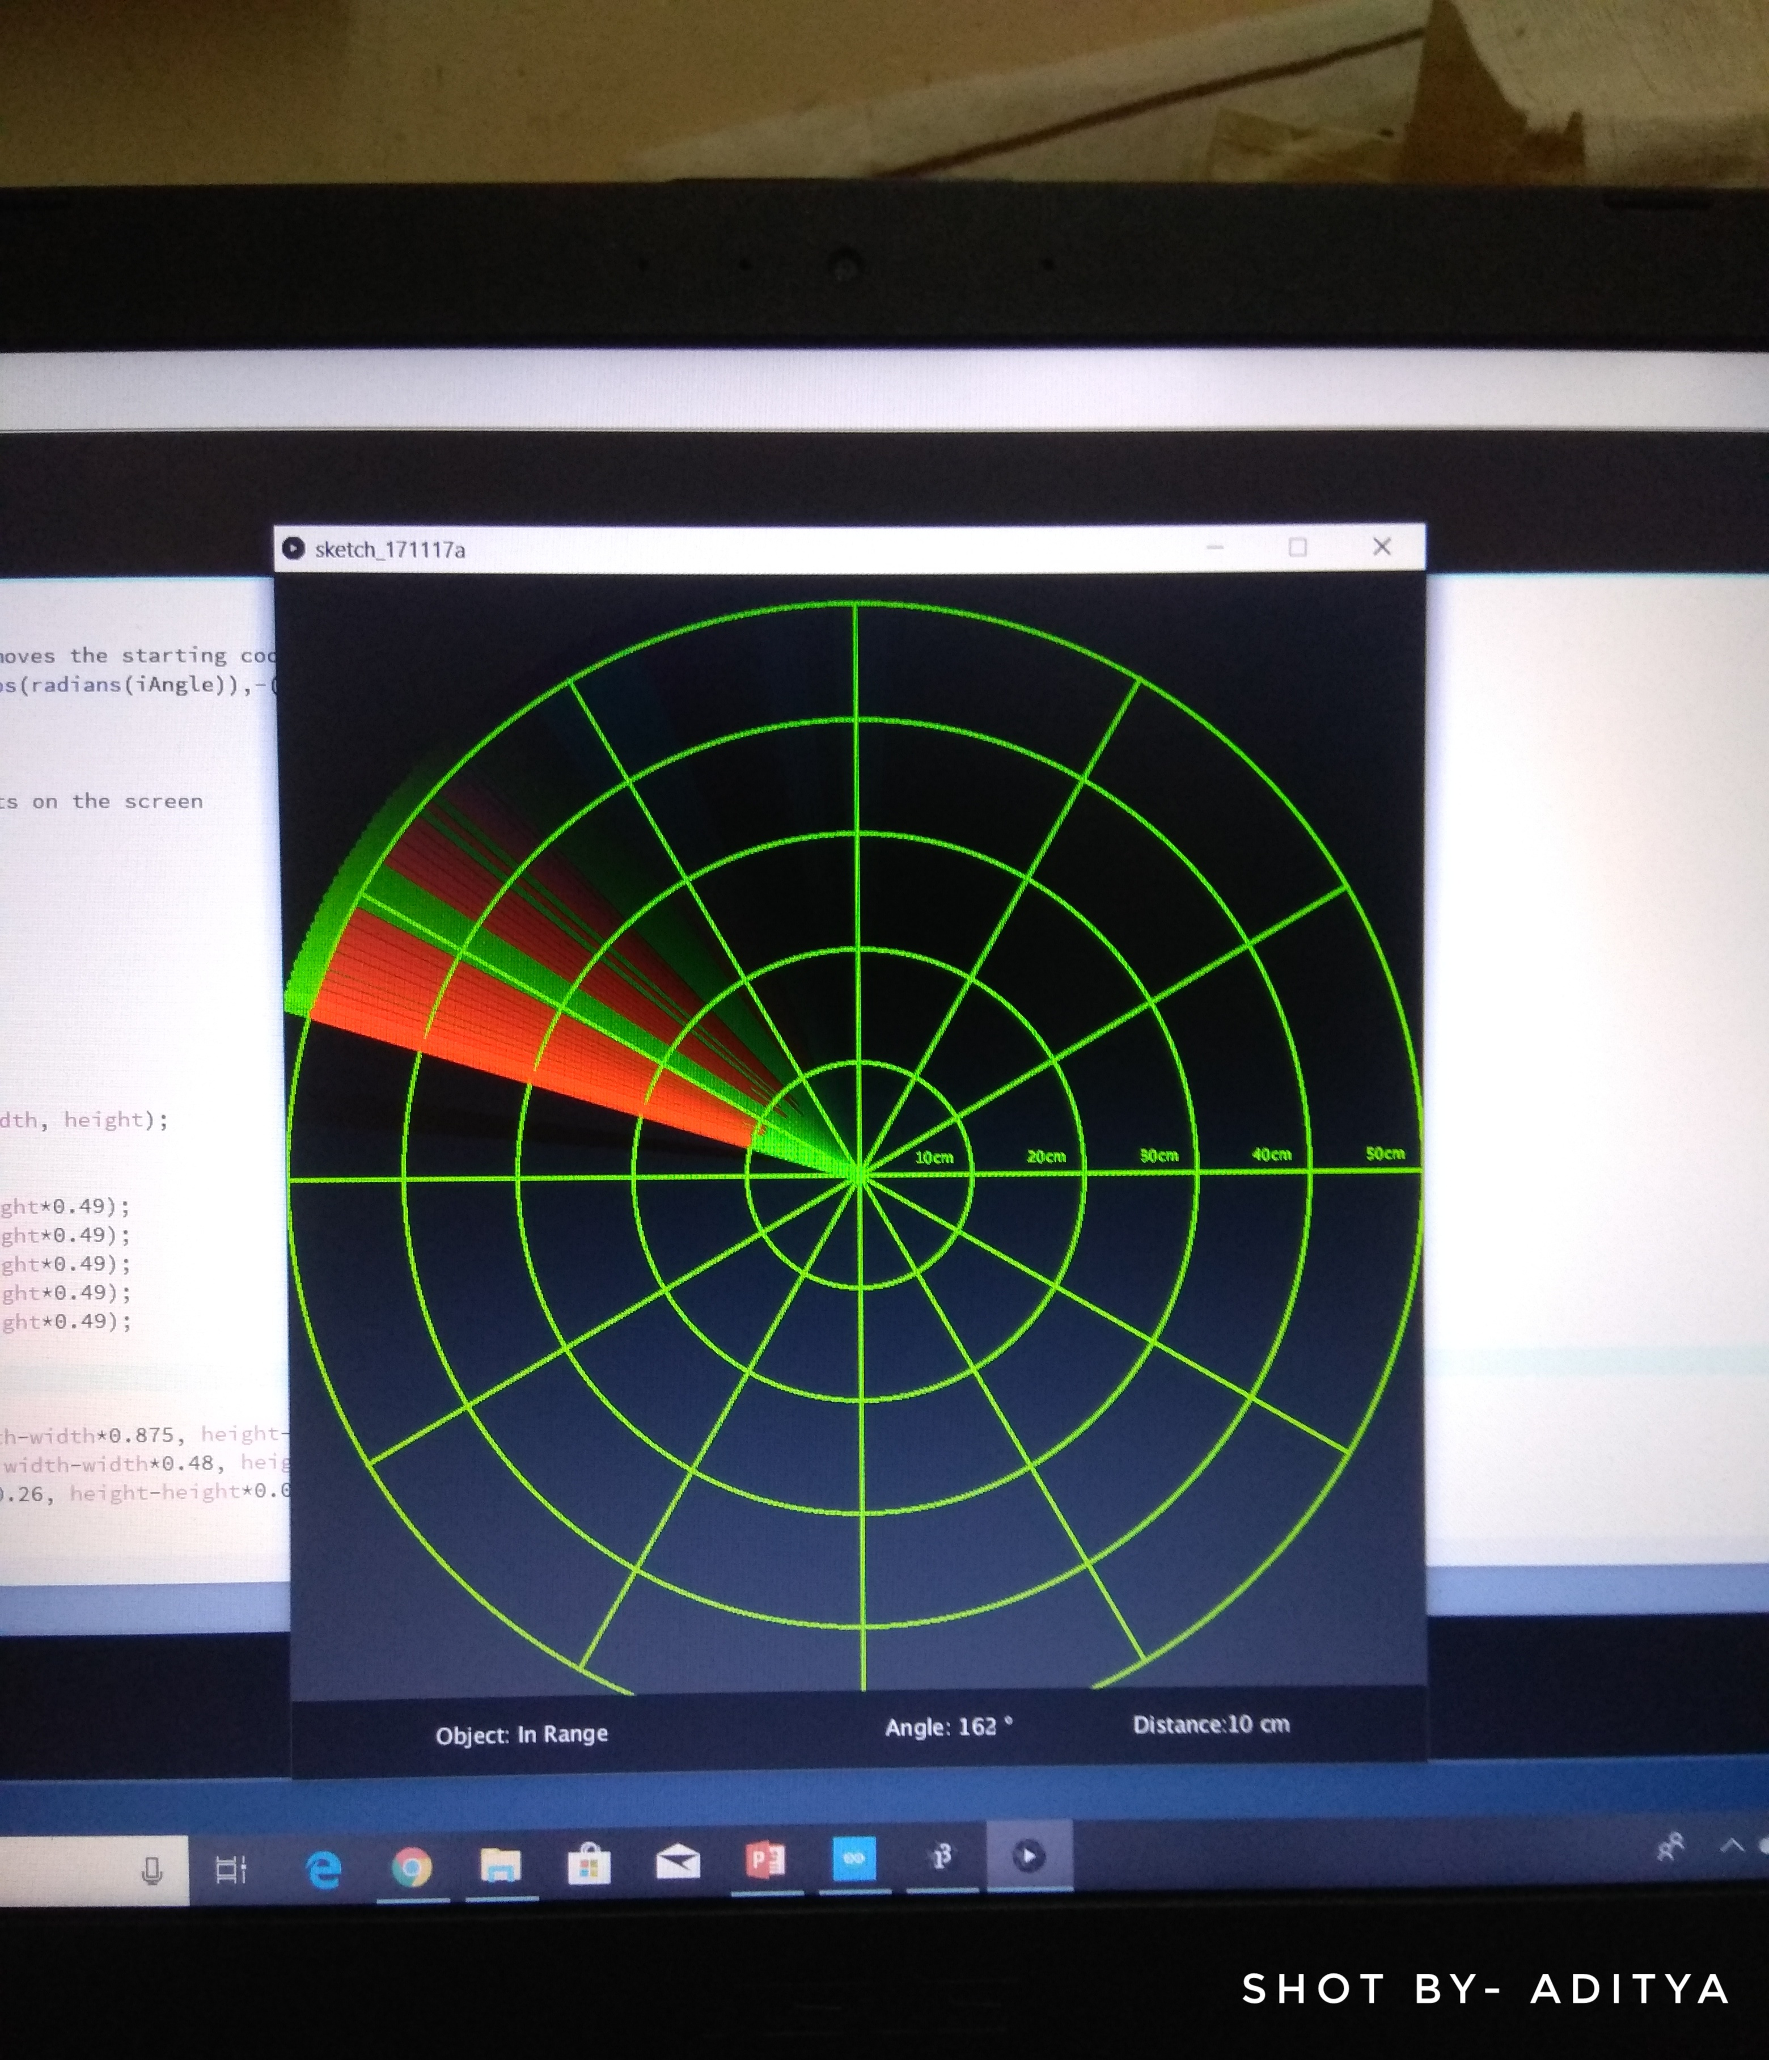
OUTPUT SAMPLES
When there is no obstacle
When an obstacle is detected

Slide 12
CONCLUSION
SUCCESSFUL DETECTION OF OBJECT.
DISPLAYING PRECISE DISTANCE AND LOCATION.
CAN BE USED MAINLY FOR OUTDOOR DETECTION PURPOSES,IF IMPLEMENTED ON A LARGE SCALE.

Slide 13
THANK YOU

